Slide 1
Case study
CareEvent

Slide 2
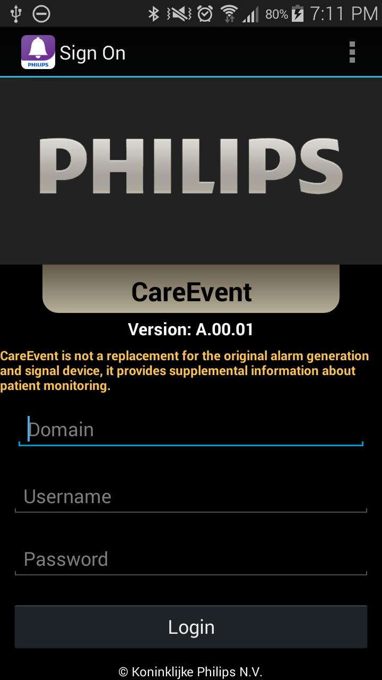
Intended use
Device Class- Class II
The intended use of Philips CareEvent is to deliver supplemental medical device data associated with physiological alarms, technical alarms, clinical notifications, nurse call alarms and informational messages to a healthcare professional’s end device.
The user may receive visual or audible notifications and/or other message notification types based on the communicator in use.

Slide 3
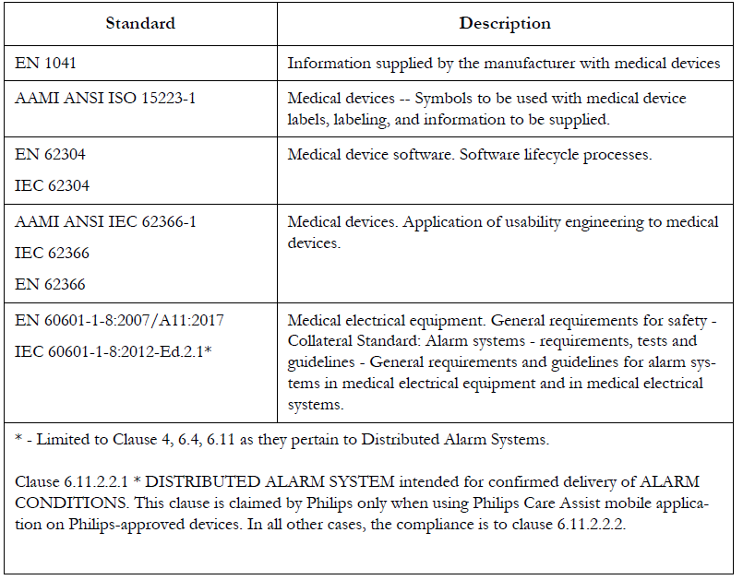
Safety Standards
The device complies with the following safety requirements for medical electrical equipment:

Slide 4
Regulatory and Safety Specifications
Declaration
The CareEvent Software complies with the requirements of the Council Directive 93/42/EEC of 14 June 1993 concerning medical devices.
It carries CE-marking to the European Medical Device Directive. Compliance with Directive 93/42/EEC is inclusive of Amending Directive 2007/47/EEC.
The PC workstation and servers carry CE-marking to the European Low Voltage and EMC Directives.
Directive as determined by the OEM supplier of the PC hardware.
Philips's system components are not suitable for installation in the Patient Care Vicinity (Patient Environment).

Slide 5
Program Details
Publisher – Philips Electronics North America Corporation
Released Date – 2018-12-20
Languages – English
Category – Home & Hobby
Sub-Category – Health & Nutrition
Operating System – ios
File size – 88.39 MB
License Model – Free
Version – 5.4

Slide 6
About CareEvent
CareEvent Showcase is a free software application from the Health & Nutrition subcategory, part of the Home & Hobby category.
The Philips CareEvent mobile application turns a smartphone into a valuable clinical notification tool to meet the workflow demands for nurses and caregivers who are constantly on the go within the hospital.
CareEvent Showcase (version 5.4) has a file size of 88.39 MB and is available for download from our website.
The CareEvent app is intended to be used by trained clinicians for review purposes only and is not intended for primary monitoring.

Slide 7
About CareEvent
The CareEvent mobile application software is designed to operate on qualified mobile devices.
These qualified mobile devices specified by Philips have been extensively tested and validated for system performance and data presentation (notification text, numeric and physiological waves).
Only these qualified mobile devices are supported by Philips for use with the CareEvent mobile application.
The list of qualified mobile devices can be found in the CareEvent Mobility Integration Guide.
The CareEvent app is fully functional with required Philips CareEvent license.
The showcase version of the CareEvent is not a medical device.

Slide 8


Project Challenges
Transfer Clinical Evaluation Report from MDD to MDR requirement.
Separate a complex CEP & CER of two products into individual documents for each during annual update.
Understand the complex product with available information, review available documents and make a checklist of required documents for completing the activity.
Change and Update Clinical Evaluation Plan in new template.
Perform additional literature search for annual update.
Analyse Internal Vigilance data, appraised and summarised as per requirement.
Change CER in new template as per MDR requirement.
Add new sections, latest literature and Vigilance data in the CER.
Separate existing one CER for two products into two standalone CER.
Service provided

Slide 9

Customer benefits
Execution the Clinical Evaluation Report in line with all the Regulatory requirements
Executed the Project with committed Quality as used Multiple level of review
Intimated the Project progress in a timely manner which helped Abbott to plan their Regulatory Submission

Slide 10
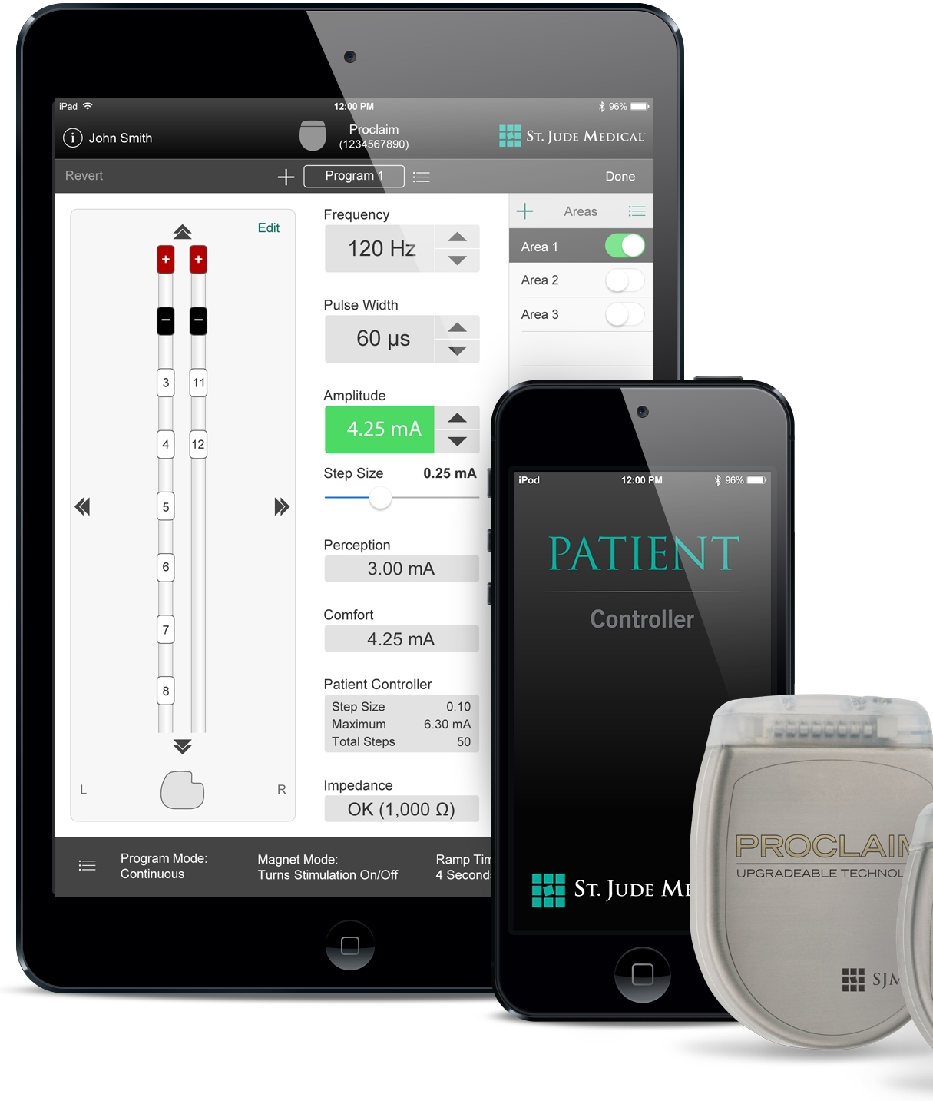
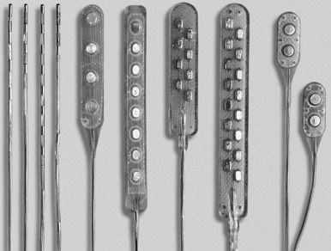
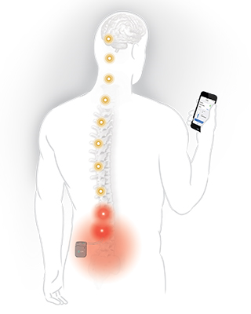
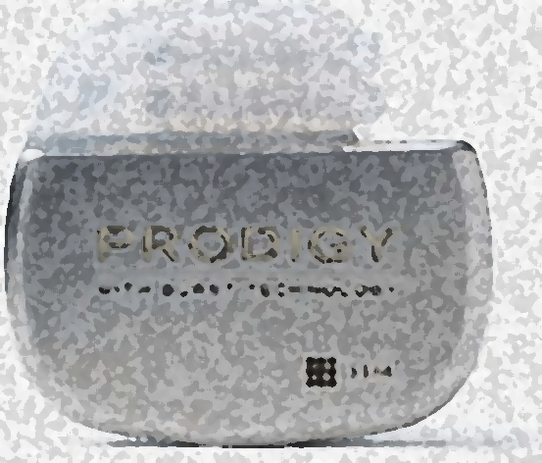




CER SUPPORT
The Challenge
  Transfer Clinical Evaluation Report from MDD to MDR requirement.
  Separate a complex CEP & CER of two products into individual documents for each during annual update.
Solution Highlights
  Understand the complex product with available information, review available documents and make a checklist of required documents for completing the activity.
  Change and Update Clinical Evaluation Plan in new template.
  Perform additional literature search for annual update.
  Analyse Internal Vigilance data, appraised and summarised as per requirement.
  Change CER in new template as per MDR requirement.
  Add new sections, latest literature and Vigilance data in the CER.
  Separate existing one CER for two products into two standalone CER.
BUSINESS VALUE DELIVERED
  Successfully transitioned the CEP & CER as per new MDR requirements
  Offshore driven project
Neuro Modulation Devices
ENGAGEMENT
TECHNOLOGY
OWNERSHIP
OUTCOME
Neuromodulation Devices
Transitioned the document as per new requirement
Remediation
90%
Notes:
Connect back to Change the Business

Slide 11
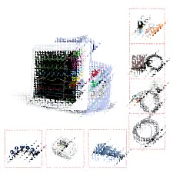
CER SUPPORT
The Challenge
  Search relevant information for the accessories in external database for literature and post market surveillance data
  Add information for the newly added accessories in the CER
Solution Highlights
  Understand the complex product with accessories and develop literature and PMS data search strategy.
  Perform the search and appraise literature data for accessories.
  Open PMS Database search in MAUDE, BfArM, TGA, MHRA.
  Trend Analysis for PMS data.
  Develop strategy to add the new accessories information in the CER.
  Change and Update Clinical Evaluation Plan & report with respect to accessories.
  Perform annual Update for CER.
BUSINESS VALUE DELIVERED
  Successfully added required information for newly added accessories in the CEP & CER
  Offshore driven project
Patient Monitoring Devices for various patient parameters
ENGAGEMENT
TECHNOLOGY
OWNERSHIP
OUTCOME
Remediation
Patient monitors
90%
Updated the document as per new product list
Notes:
Connect back to Change the Business

